Slide 1

VISUAL ANALYTICS on LAST 5 YEARS OF SERIE A STATISTICS
Master Degree in Engineering in Computer Science
(aa 2019/20)
Umberto di Canito
Daniele Buonadonna

Slide 2
Introduction
The main goal of this application is related to visualization of the latest five years statistic of first italian soccer league Serie A
Data selection through filter menu
Useful to analyze matches and predict future matches results
Simple information visualization

Slide 3

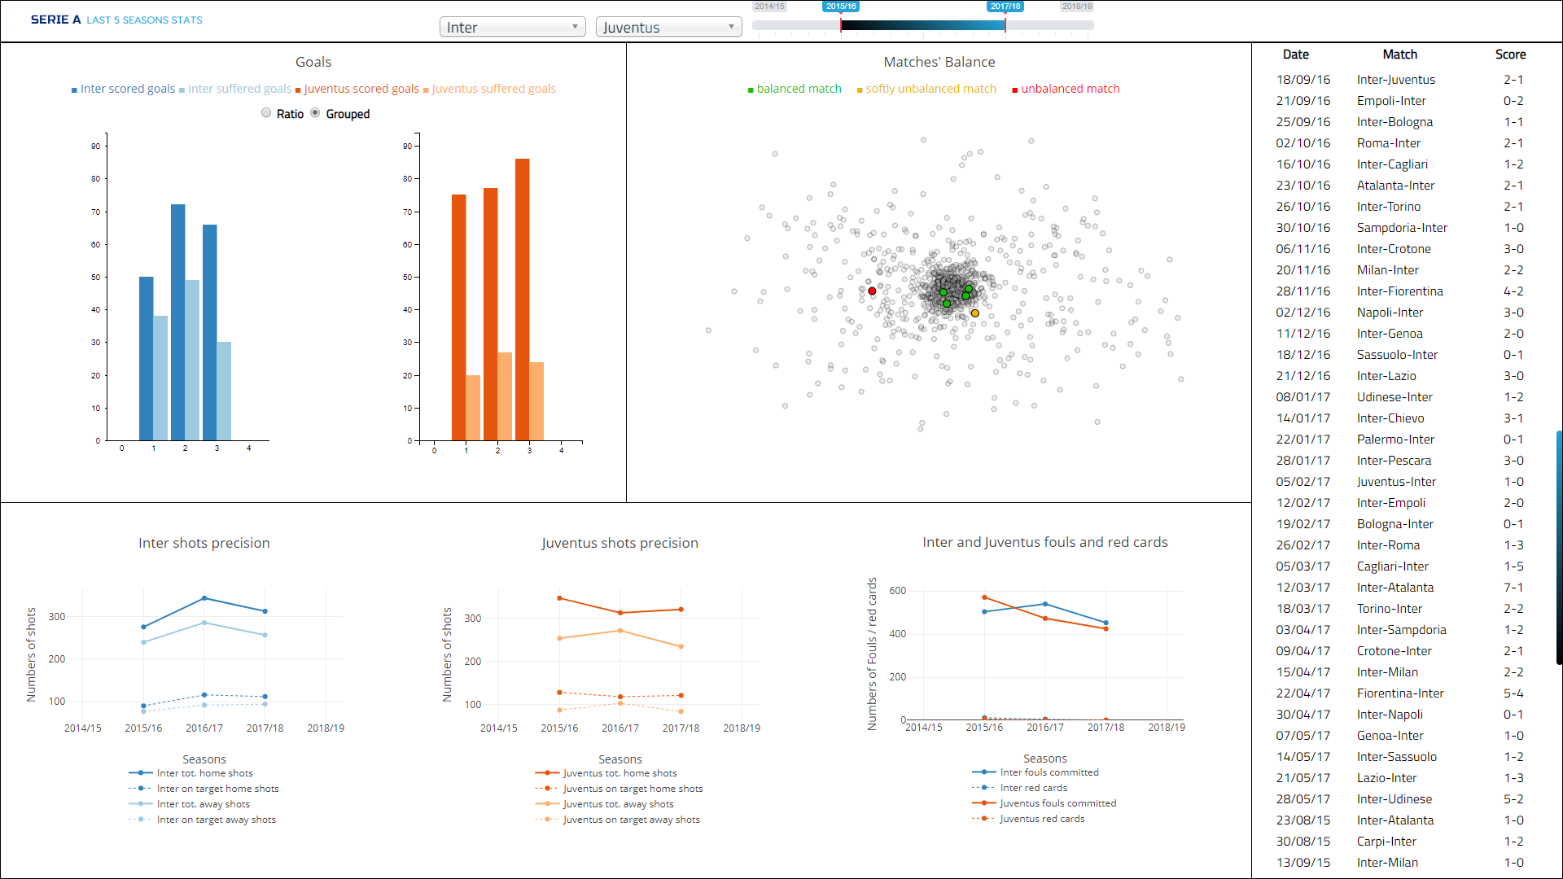
Overview
5 views including :
Stacked to Grouped Barchart
Scatterplot
Multiline Chart
Table

Slide 4
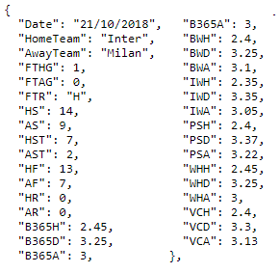
Dataset
Serie A statistics from Datahub.io, from 2014/15 to 2018/19
1905 tuples
32 attributes (both categorical and numerical)
AS Index of 60960

Slide 5
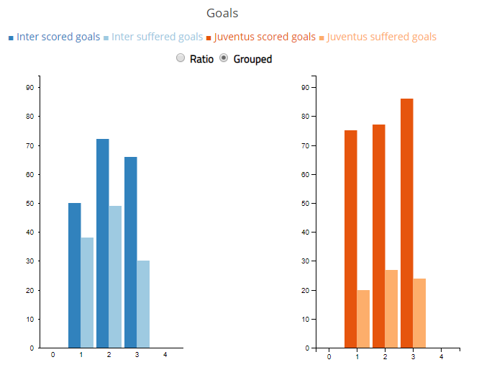
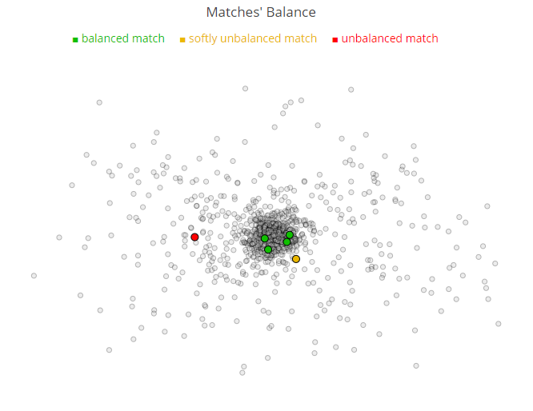
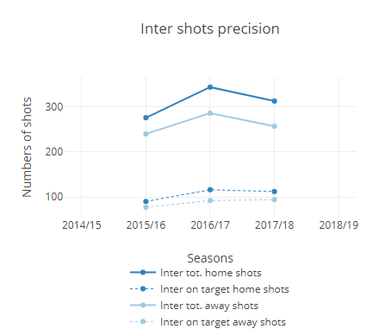
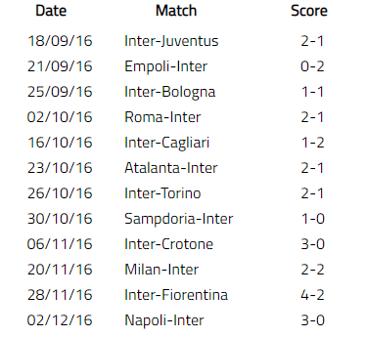
Interface
Seasons slider to select years.
Automatic update of all the views when the user changes choices of teams and seasons.

Slide 6
Stacked to Grouped Barchart
scored and suffered goals
The user can change from Stacked to Grouped and viceversa
Stacked represent the ratio between scored and suffered goal
User can see the details by pointing with the mouse on the bars
Diverging colors to highlights the opposing teams
Chromatic sequential colors to represents data of the same team

Slide 7
Scatterplot
matches balance
MDS representation of similarity among matches
Each point represents a match
The more the point is in the center of the view and the more the match is balanced
Based on the density from the center is possible to classify the matches categories

Slide 8

Multiline Charts
shots precision
Represention of the precision of shots
continous line for the total shots
dotted line for the shots on the target
interactive legend acts like filter
A view of this type for each team
User can see the details by pointing with the mouse on the points, along with the seasons

Slide 9
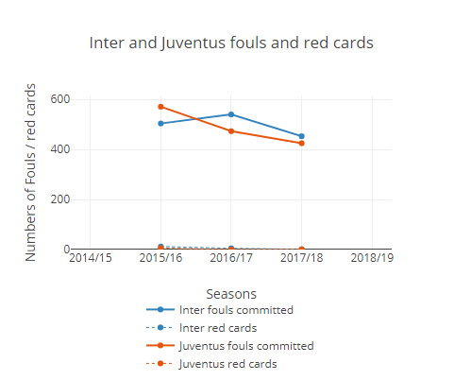
Multiline Charts
relation between fouls and red cards
Represention of the relation between fouls and red cards of the teams
continous line for the fouls
dotted line for the red cards
interactive legend acts like filter
Thanks to this legend filter is easy to see both statistics of teams
User can see the details by pointing with the mouse on the points, along with the seasons

Slide 10
Table
matches results
Represention of the matches results
If only one team is selected the table will show all the matches played
If two teams are selected the table will show the direct matches between those two teams
Matches are ordered by the most recent season

Slide 11
Interactions between Scatterplot and Table
Whenever the user pass over a point in the Scatterplot, the corresponding row relative to that match will be highlighted, using the same color of the category of the point.

Slide 12
MDS Similarity Computation
Each tuple has 18 differents odd values from 6 odd’s agencies.
For each tuple (match) we computed a “balance” estimator = max odd value - min odd value
We computed the dissimilarity matrix whereby each field (i,j) of this matrix is the difference between the balance estimators of the match i and match j
Dissimilarity matrix is given then to the MultiDimensional Scaling algorithm

Slide 13
Analytics
Original dataset was reduced in order to make it more suitable for our purposes
The edited dataset is stored on JSON file online and downloaded before the computation of the various views
MDS computation has been done once. The output is stored on JSON file online too.
All the computations useful for the views are done dynamically
All the updates of the views are done automatically after the menu choices of the users.

Slide 14
Conclusions
Useful tool for anyone
Easy way to acquire information
Can be useful to make future predictions about future matches of the new season
A possible future add-on for the implementation could be the player statistics on the scored goals, percent of passages, etc...

Slide 15

Thank You
Umberto di Canito
dicanito.1851685@studenti.uniroma1.it
Daniele Buonadonna
buonadonna.1855047@studenti.uniroma1.it

